Slide 1
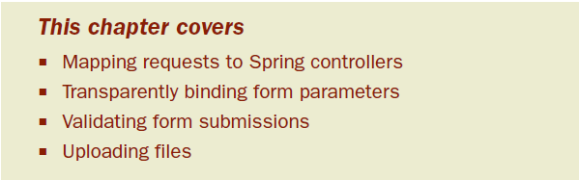
Chapter 7: Building web applications with Spring MVC
For many Java developers, web-based applications are their primary focus.
Challenges: state management, workflow, validation, etc.
None of these is made any easier given the HTTP protocol’s stateless nature.

Slide 2
Spring’s web framework is designed to help you address these concerns.
Based on the Model-View-Controller (MVC) pattern
Flexible
Loosely-coupled

Slide 3
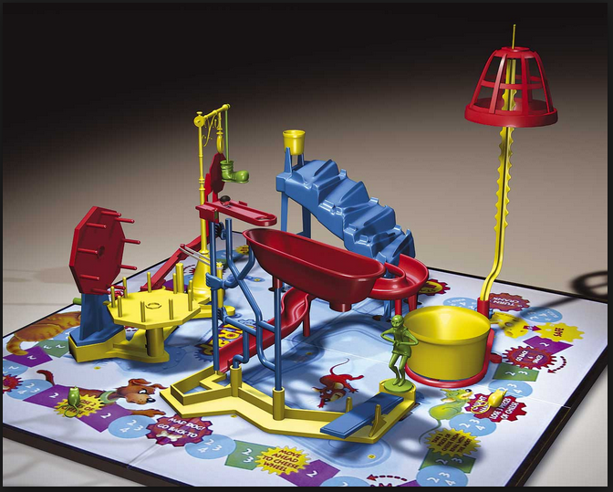
7.1 Getting started with Spring MVC
Notes:
The goal is to send a small steel ball over a series of wacky contraptions in order to trigger a mousetrap. The ball goes over all kinds of intricate gadgets, from rolling down a curvy ramp to springing off a teeter-totter to spinning on a miniature Ferris wheel to being kicked out of a bucket by a rubber boot. It goes through all of this to spring a trap on a poor, unsuspecting plastic mouse.

Slide 4
Instead of moving a ball around through various ramps, teeter-totters, and wheels, Spring moves requests around between a dispatcher servlet, handler mappings, controllers, and view resolvers.
Each of the components in Spring MVC performs a specific purpose.

Slide 5
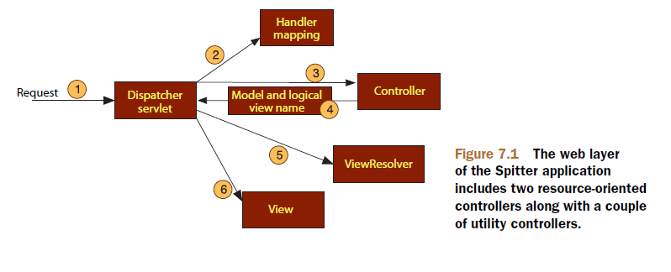
7.1.1 Following a request through Spring MVC
Every time a user clicks a link or submits a form in their web browser, a request goes to work.
Notes:
-The request is a busy fellow. From the time it leaves the browser until it returns with a response, it’ll make several stops, each time dropping off a bit of information and picking up some more.

Slide 6
The first stop in the request’s travels is at Spring’s DispatcherServlet.
The DispatcherServlet’s job is to send the request on to a Spring MVC controller.
the DispatcherServlet consults one or more handler mappings to figure out where the request’s next stop will be.
The handler mapping will pay particular attention to the URL carried by the request when making its decision.
At the controller, the request will drop off its payload (the information submitted by the user) and patiently wait while the controller processes that information - delegates responsibility for the business logic to one or more service objects.
Notes:
-Like most Java-based web frameworks, Spring MVC funnels requests through a single front con-troller servlet.

Slide 7
logic performed by a controller often results in some information that needs to be carried back to the user and displayed in the browser – model
Forward to a view – JSP(typically)
One of the last things that a controller does is package up the model data and identify the name of a view that should render the output – model and view name back to the DispatcherServlet
The view will use the model data to render output that will be carried back to the client by the (not- so-hardworking) response object.
Notes:
-So that the controller doesn’t get coupled to a particular view, the view name passed back to DispatcherServlet doesn’t directly identify a specific JSP. In fact, it doesn’t even necessarily suggest that the view is a JSP at all. Instead, it only carries a logical name which will be used to look up the actual view that will produce the result. The DispatcherServlet will consult a view resolver to map the logical view name to a specific view implementation, which may or may not be a JSP.

Slide 8
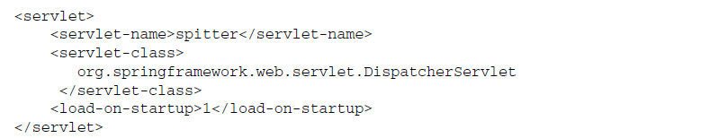
7.1.2 Setting up Spring MVC
At the heart of Spring MVC is DispatcherServlet
By default, when DispatcherServlet is loaded, it’ll load the Spring application context from an XML file whose name is based on the name of the servlet (spitter-servlet.xml)

Slide 9
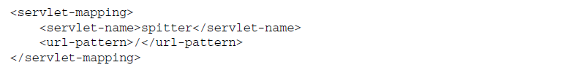
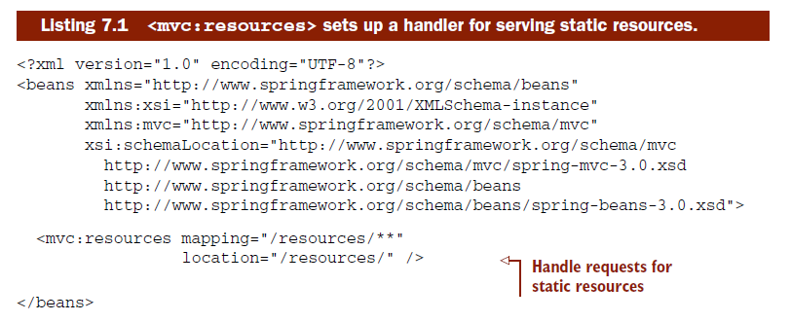
Next we must indicate what URLs will be handled by the DispatcherServlet.
Spring’s mvc namespace includes a new <mvc:resources> element that handles requests for static content for you.
Notes:
-By mapping DispatcherServlet to /, I’m saying that it’s the default servlet and that it’ll be responsible for handling all requests, including requests for static content.

Slide 10
<mvc:resources> sets up a handler for serving static content.
The mapping attribute is set to /resources/**, which includes an Ant-style wildcard to indicate that the path must begin with /resources, but may include any subpath thereof

Slide 11
Exercise 7-1
Configure web.xml to include DispatcherServlet
Configure spitter-servlet.xml to include <mvc:resources> for static contents

Slide 12
7.2 Writing a basic controller
As we develop the web functionality for the Spitter application, we’re going to develop resource-oriented controllers.
The Spitter application, being rather simple, has only two primary resource types: Spitters who are the users of the application and the spittles that they use to communicate their thoughts.

Slide 13
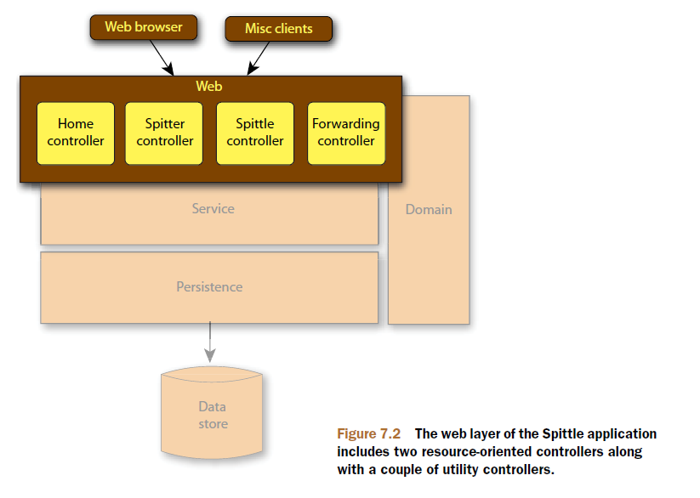
Notes:
-But first, since we’re developing annotation-driven controllers, there’s a bit more setup to do.

Slide 14
7.2.1 Configuring an annotation-driven Spring MVC
DispatcherServlet consults one or more handler mappings in order to know which controller to dispatch a request to.
BeanNameUrlHandlerMapping—Maps controllers to URLs that are based on the controllers’ bean names.
ControllerBeanNameHandlerMapping—Similar to BeanNameUrlHandlerMapping. In this case, the bean names aren’t required to follow URL conventions.
ControllerClassNameHandlerMapping—Maps controllers to URLs by using the controllers’ class names as the basis for their URLs.
DefaultAnnotationHandlerMapping—Maps request to controller and control ler methods that are annotated with @RequestMapping.
SimpleUrlHandlerMapping—Maps controllers to URLs using a property collection defined in the Spring application context.

Slide 15
If no handler mapping beans are found, then DispatcherServlet creates and uses BeanNameUrlHandlerMapping and DefaultAnnotationHandlerMapping.
But there’s more to annotation-driven Spring MVC than just mapping requests to methods.
bind request parameters to handler method parameters
perform validation
perform message conversion
Notes:
Although small, the <mvc:annotation-driven> tag packs a punch. It registers several features, including JSR-303 validation support, message conversion, and support for field formatting.

Slide 16
7.2.2 Defining the home page controller
In the case of the Spitter application, the home page’s main job is to welcome visitors and to display a handful of recent spittles, hopefully enticing the visitors to join in on the conversation.

Slide 17
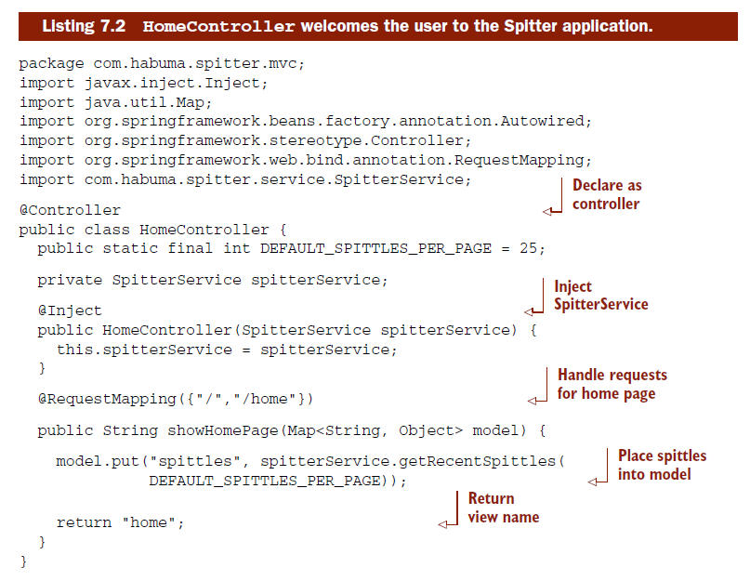

Slide 18
The real work takes place in the showHomePage() method. As you can see, it’s annotated with @RequestMapping.
As we write more controllers we’ll see that the signature of a request-handling method can include almost anything as an argument
HttpServletRequest,
HttpServlet- Response,
String
numeric parameters that correspond to query parameters in the request
cookie values,
HTTP request header values

Slide 19
The last thing that showHomePage() does is return a String value that’s the logical name of the view that should render the results.
After the controller has finished its work, DispatcherServlet will use this name to look up the actual view implementation by consulting a view resolver.
Notes:
-After the controller has finished its work, DispatcherServlet will use this name to look up the actual view implementation by consulting a view resolver.

Slide 20
Exercise 7-2
Write HomeController.java

Slide 21
TESTING THE CONTROLLER
What’s most remarkable about HomeController (and most Spring MVC controllers) is that there’s little that’s Spring-specific about it. In fact, if you were to strip away the three annotations, this would be a POJO.

Slide 22
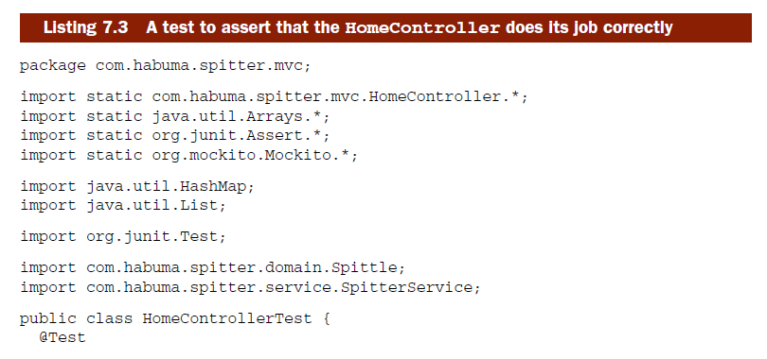
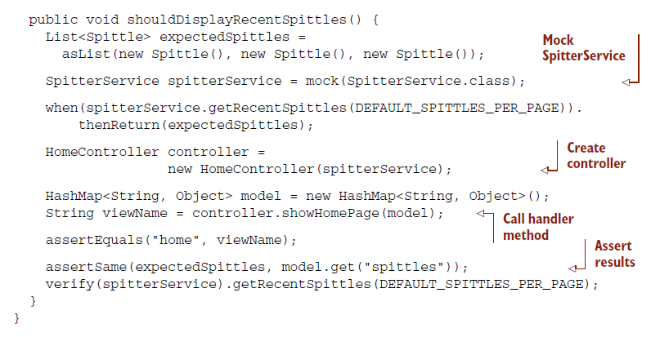
Notes:
Run HomeControllerTest.java

Slide 23
7.2.3 Resolving views
The last thing that must be done in the course of handling a request is rendering output to the user.
In order to figure out which view should handle a given request, DispatcherServlet consults a view resolver to exchange the logical view name returned by a controller for an actual view that should render the results.

Slide 24
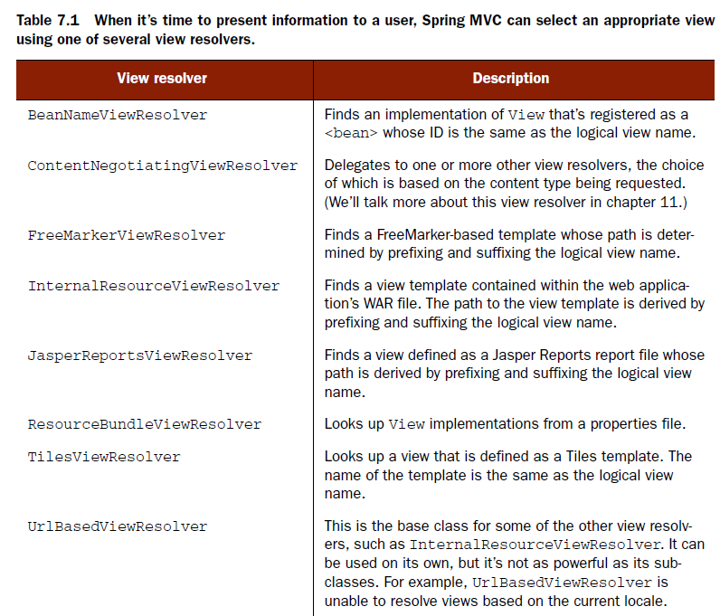
implementation of org.springframework.web.servlet.View.

Slide 25
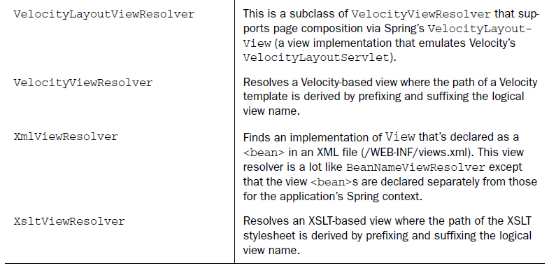

Slide 26
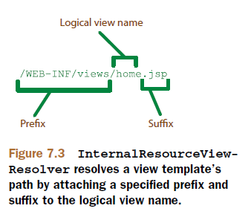
RESOLVING INTERNAL VIEWS
A lot of Spring MVC embraces a convention-over-configuration approach to development - InternalResourceViewResolver

Slide 27
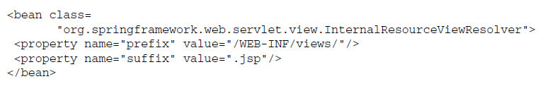
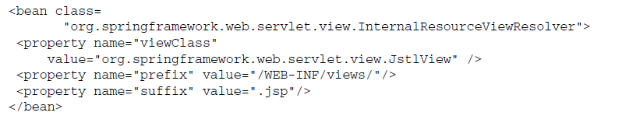
When DispatcherServlet asks InternalResourceViewResolver to resolve a view, it takes the logical view name, prefixes it with /WEB-INF/views/ and suffixes it with .jsp.
Notes:
-By default the View object that InternalResourceViewResolver creates is an instance of InternalResourceView, which simply dispatches the request to the JSP for rendering. But since home.jsp uses some JSTL tags, we may choose to replace InternalResourceView with JstlView by setting the viewClass property

Slide 28
JstlView dispatches the request to JSP, just like InternalResourceView. But it also exposes JSTL-specific request attributes so that you can take advantage of JSTL’s internationalization support.
Although we won’t delve into the details of FreeMarkerViewResolver, Jasper- ReportsViewResolver, VelocityViewResolver, VelocityLayoutViewResolver, or XsltViewResolver, they’re all similar to InternalResourceViewResolver in that they resolve views by adding a prefix and a suffix to the logical view name to find a view template.

Slide 29
Using InternalResourceViewResolver to resolve to JSP views is fine for a simple web application with an uncomplicated look and feel.
But websites often have interesting user interfaces with some common elements shared between pages. For those kinds of sites, a layout manager such as Apache Tiles is in order.

Slide 30
RESOLVING TILES VIEWS
Apache Tiles is a templating framework for laying out pieces of a page as fragments that are assembled into a full page at runtime.
This modest <bean> declaration sets up a view resolver that attempts to find views that are Tiles template definitions where the logical view name is the same as the Tiles definition name.
Notes:
-Although it was originally created as part of the Struts framework, Tiles proved to be useful with other web frameworks.

Slide 31
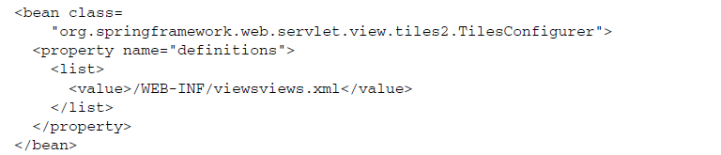
What’s missing is how Spring knows about Tiles definitions.
TilesConfigurer loads one or more Tiles definition files and make them available for TilesViewResolver to resolve views from.
Notes:
-For the Spitter application we’re going to have a few Tiles definition files, all named views.xml, spread around under the /WEB-INF/views folder.

Slide 32
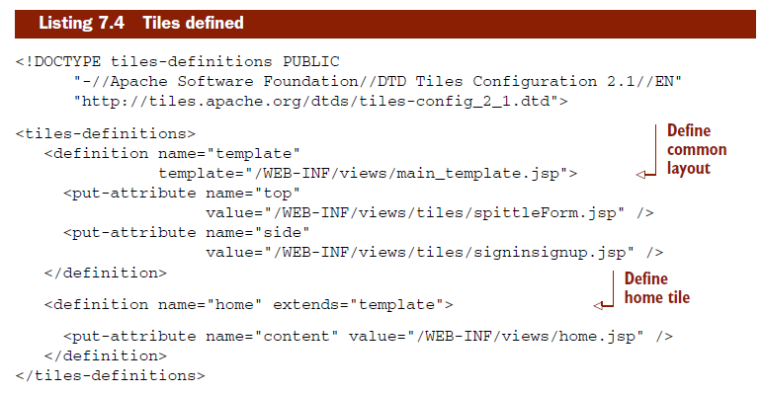
The home definition extends the template definition, using home.jsp as the JSP that renders the main content of the page, but relying on template for all of the common features of the page.

Slide 33
Exercise 7-3
Write a TilesViewResolver to spitter-servlet.xml

Slide 34
7.2.4 Defining the home page view
The main_template.jsp file describes the common layout for all pages in the Spitter application, while home.jsp displays the main content for the home page. Plus, spittleForm.jsp and signinsignup.jsp provide some additional common elements.

Slide 35
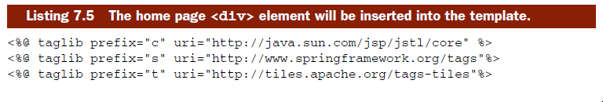
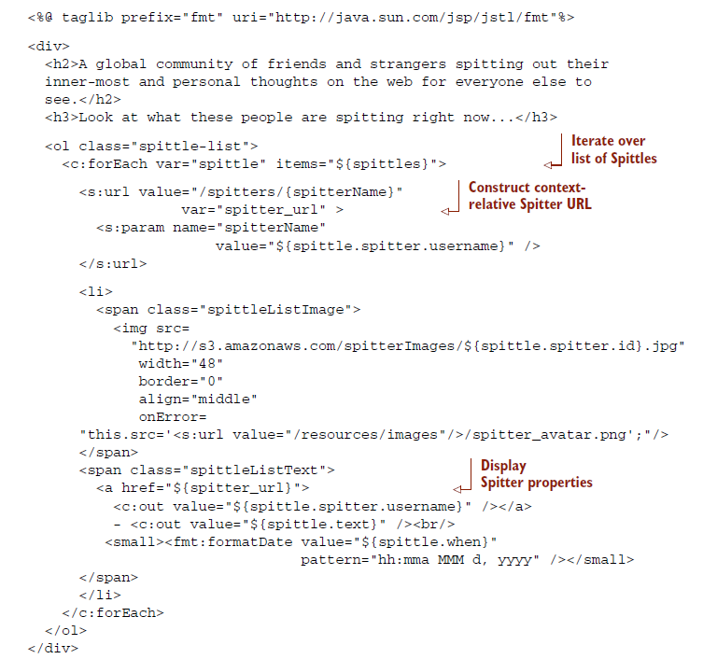

Slide 36
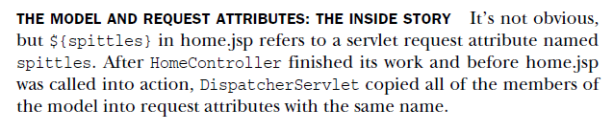
The main difference between Spring’s <s:url> and JSTL’s <c:url> is that <s:url> supports parameterized URL paths.

Slide 37
7.2.5 Rounding out the Spring application context
Although not strictly required, it’s a good idea to organize our Spring configuration across multiple files.
ContextLoaderListener is a servlet listener that loads additional configuration into a Spring application context alongside the application context created by DispatcherServlet.
Notes:
-With that in mind, it makes sense to put all of the web layer configuration in spitter-servlet.xml, the file loaded by Dispatcher- Servlet. But we still need a way to load the other configuration files.

Slide 38
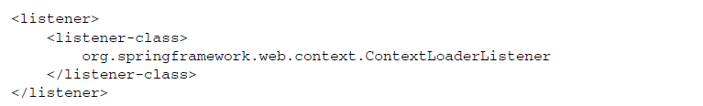
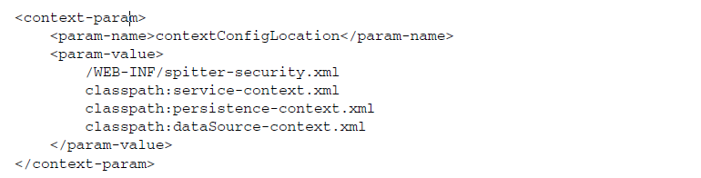
If not specified, the context loader will look for a Spring configuration file at /WEB-INF/applicationContext.xml.
Notes:
Unless specified otherwise, the paths are relative to the application root.

Slide 39
Exercise 7-4
Add the ContextLoaderListener to web.xml
Load configuration files.
Run jetty
Notes:
-Now we have our first controller written and ready to serve requests for the Spitter application’s home page. If all we needed is a home page, we’d be done. But there’s more to Spitter than just the home page, so let’s continue building out the application. The next thing we’ll try is to write a controller that can handle input.

Slide 40
7.3 Handling controller input
Controllers are often asked to perform some logic against one or more pieces of information that are passed in as URL parameters or as form data.
SpitterController
SpittleController

Slide 41
7.3.1 Writing a controller that processes input
One way that we could implement SpitterController is to have it respond to a URL with the Spitter’s username as a request query parameter.
For example, “http://localhost:8080/spitter/spittles?spitter=habuma” could be the URL for displaying all of the Spittles for a Spitter whose username is habuma.

Slide 42
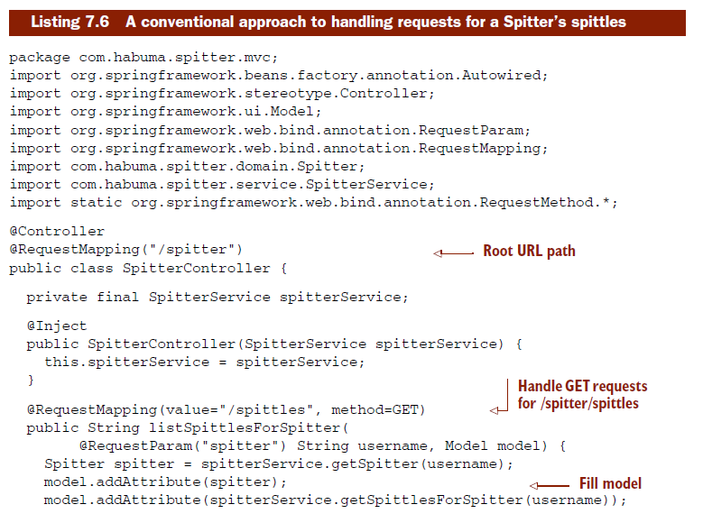


Slide 43
The class-level @RequestMapping defines the root URL path that this controller will handle.
Taken together, that means that listSpittlesForSpitter() handles requests for /spitter/spittles.
The method attribute is set to GET indicating that this method will only handle HTTP GET requests for /spitters/spittles

Slide 44
The listSpittlesForSpitter() method takes a String username and a Model object as parameters.
The username parameter is annotated with @RequestParam("spitter") to indicate that it should be given the value of the spitter query parameter in the request.
The truth be known, the object passed in as a Model likely is a Map<String, Object> under the covers.
The addAttribute() method does pretty much the same thing as Map’s put() method, except that it figures out the key portion of the map on its own.

Slide 45
Exercise 7-5
Write SpitterController.

Slide 46

7.3.2 Rendering the view
We need to show the name of the Spitter (so that it’s clear whom the list of Spittles belongs to) and then list each Spittle.
listSpittlesForSpitter() returns spittles/list as its logical view name

Slide 47
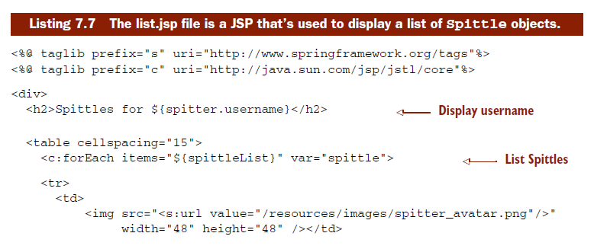
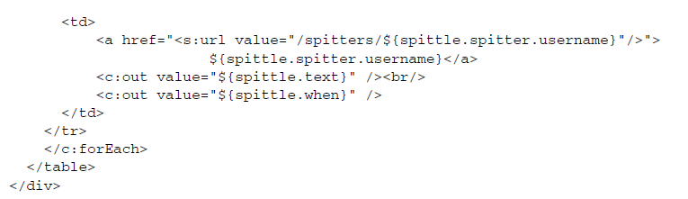

Slide 48
Exercise 7-6
Write the new tiles definition in /WEB-INF/views/spittles/views.xml
Write /WEB-INF/views/spittles/list.jsp
Run Jetty

Slide 49
7.4 Processing forms
Working with forms in a web application
Displaying the form
Processing the form submission

Slide 50
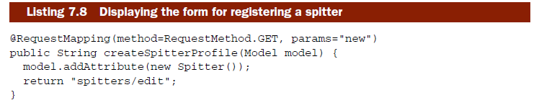
7.4.1 Displaying the registration form
This method handles requests for the path specified in the class-level @RequestMapping—/spitters in the case of SpitterController.

Slide 51
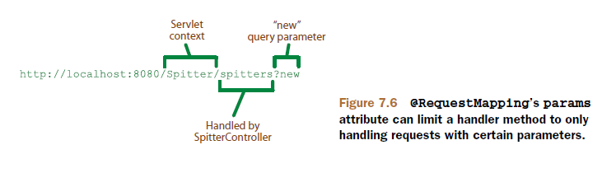
handle HTTP GET requests only
params attribute set to new
Notes:
As for the inner workings of createSpitterProfile(), it simply creates a new instance of a Spitter and adds it to the model. It then wraps up by returning spit- ters/edit as the logical name of the view that will render the form.

Slide 52
Exercise 7-7
Add the createSpitterProfile() method

Slide 53

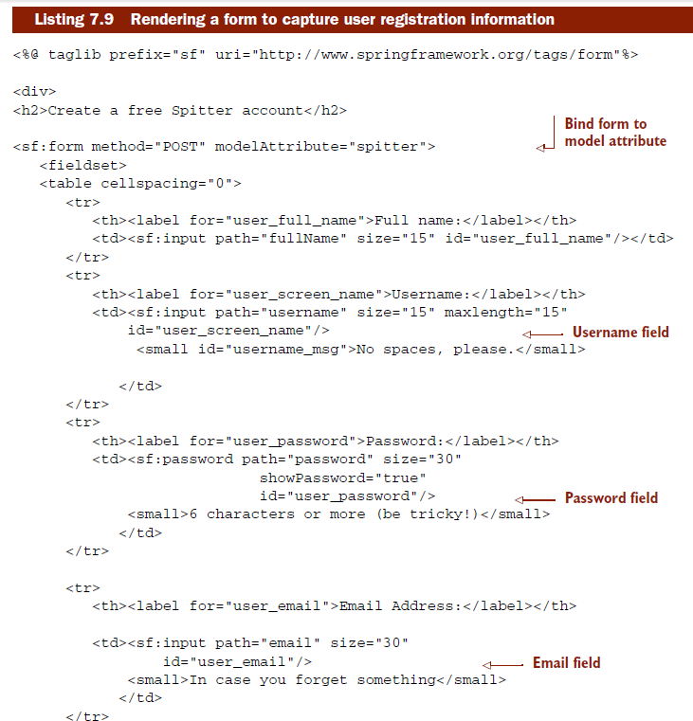
DEFINING THE FORM VIEW

Slide 54
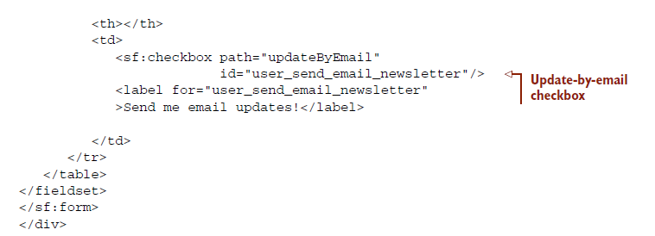
What makes this JSP file different than the others we’ve created so far is that it uses Spring’s form binding library.
The <sf:form> tag binds the Spitter object (identified by the modelAttribute attribute) that createSpitterProfile() placed into the model to the various fields in the form.

Slide 55
The <sf:input>, <sf:password>, and <sf:checkbox> tags each have a path attribute that references the property of the Spitter object that the form is bound to
Note that the <sf:form> specifies that it’ll be submitted as an HTTP POST request.
What it doesn’t specify is the URL

Slide 56
Exercise 7-8
Define the form view (tiles definition and edit.jsp)

Slide 57
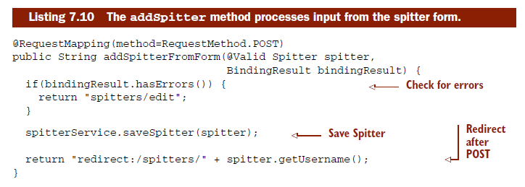
7.4.2 Processing form input

Slide 58
The difference is that where createSpitterProfile() handles GET requests, addSpitterFromForm() handles POST requests.
@Vallid indicates that the Spitter should pass validation before being passed in.
The redirect: prefix signals that the request should be redirected to the path that it precedes.

Slide 59
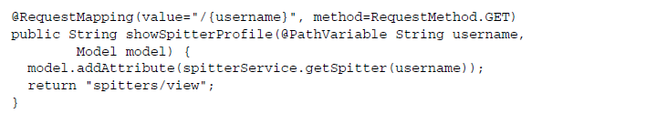
HANDLING REQUESTS WITH PATH VARIABLES
The {user- name} portion of the path is a placeholder that corresponds to the username method parameter that’s annotated with @PathVariable.

Slide 60
7.4.3 Validating input
When a user registers with the Spitter application, there are certain requirements that we’d like to place on that registration.
Full name
Email
Username
Password
The @Valid annotation tells Spring that the Spitter object should be validated as it’s bound to the form input

Slide 61
Should anything go wrong while validating the Spitter object, the validation error will be carried to the addSpitterFromForm() method via the BindingResult that’s passed in on the second parameter.

Slide 62
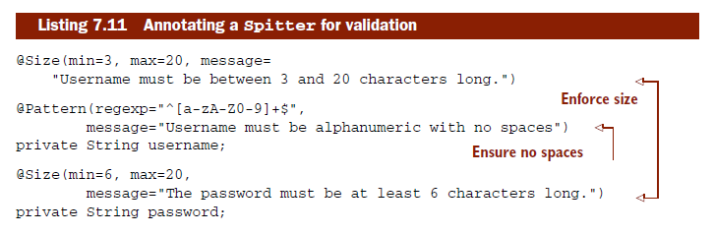
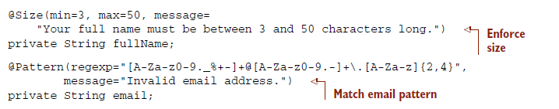
DECLARING VALIDATION RULES
Notes:
-Among other things, JSR-303 defines a handful of annotations that can be placed on properties to specify validation rules.
-With these annotations in place, when a user submits a registration form to SpitterController’s addSpitterFromForm() method, the values in the Spitter object’s fields will be weighed against the validation annotations. If any of those rules are broken, then the handler method will send the user back to the form to fix the problem.

Slide 63
DISPLAYING VALIDATION ERRORS
One way of displaying those errors to the users is to access those field errors through BindingResult’s getFieldError() method
<sf:errors> - better way

Slide 64
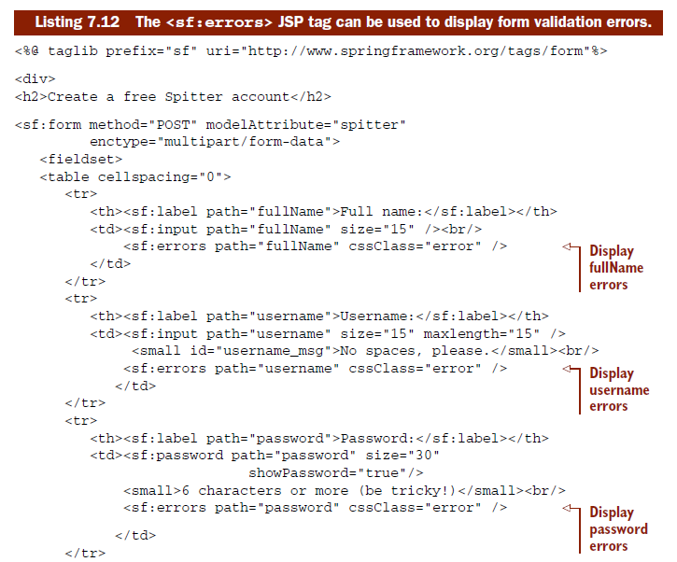

Slide 65
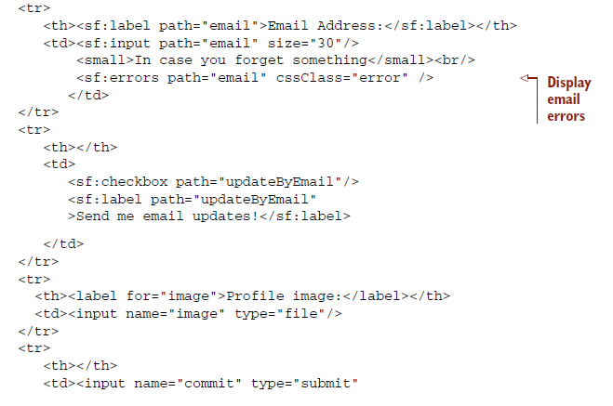
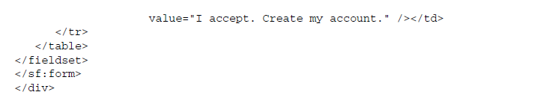

Slide 66
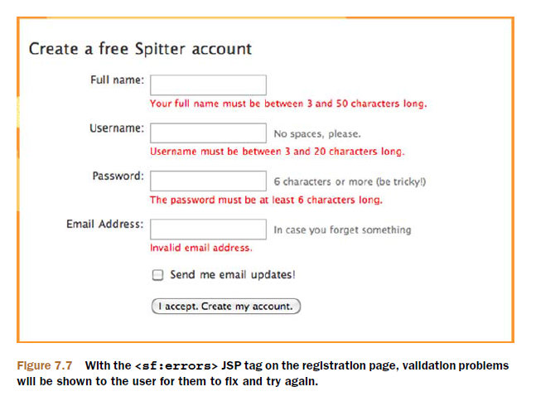
If there are multiple errors for a single field, they’ll all be displayed, separated by an HTML <br/> tag

Slide 67
Display all errors:

Slide 68
Exercise 7-9
Define addSpitterFromFormMethod()
Define showSpitterProfile()
Add validations to Spitter
Make sure errors will be displayed on front view

Slide 69
7.5 Handling file uploads
To enable file uploads in the Spitter application, we’ll need to do three things:
Add a file upload field to the registration form
Tweak SpitterController’s addSpitterFromForm() to receive the uploaded file
Configure a multipart file resolver in Spring

Slide 70
7.5.1 Adding a file upload field to the form
A typical form submission has a content type of application/x-www- form-urlencoded
Uploaded files are typically binary files and don’t fit well into the name-value pair paradigm

Slide 71
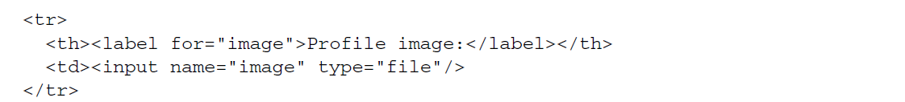
With enctype set to multipart/form-data, each field will be submitted as a distinct part of the POST request and not as just another name-value pair.
When the form is submitted, it’ll be posted as a multipart form where one of the parts contains the image file’s binary data.

Slide 72
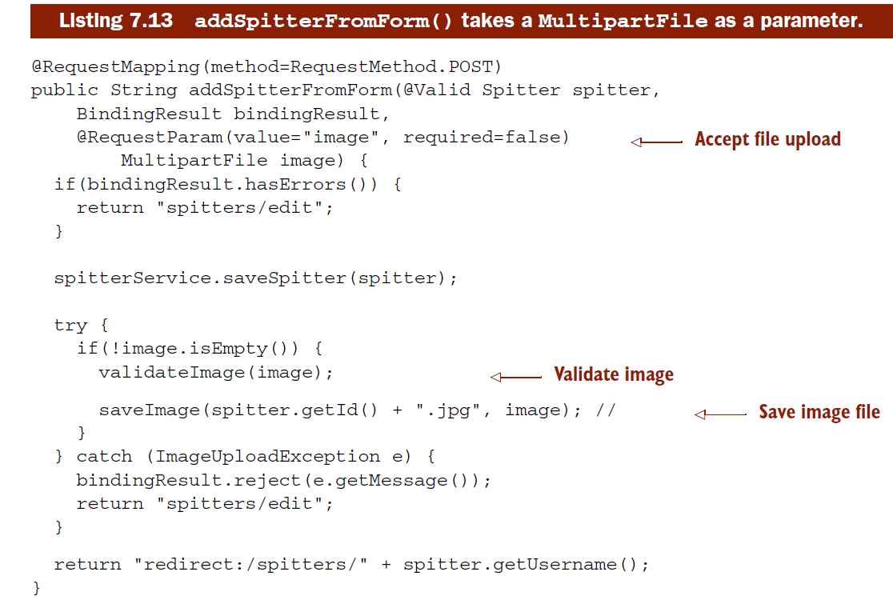
7.5.2 Receiving uploaded files

Slide 73
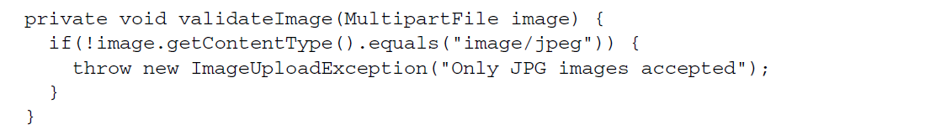
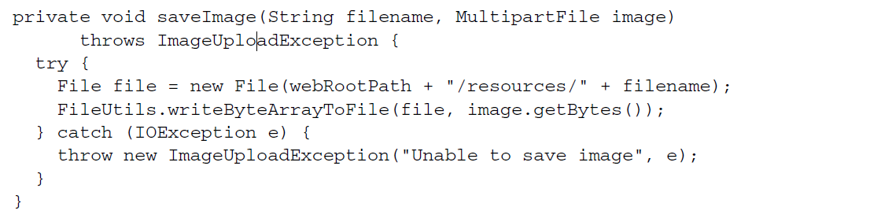

Slide 74
SAVING FILES TO AMAZON S3
The easiest way to use S3 in Java is with the JetS3t library.7 JetS3t is an open source library for saving and reading files in the S3 cloud.

Slide 75
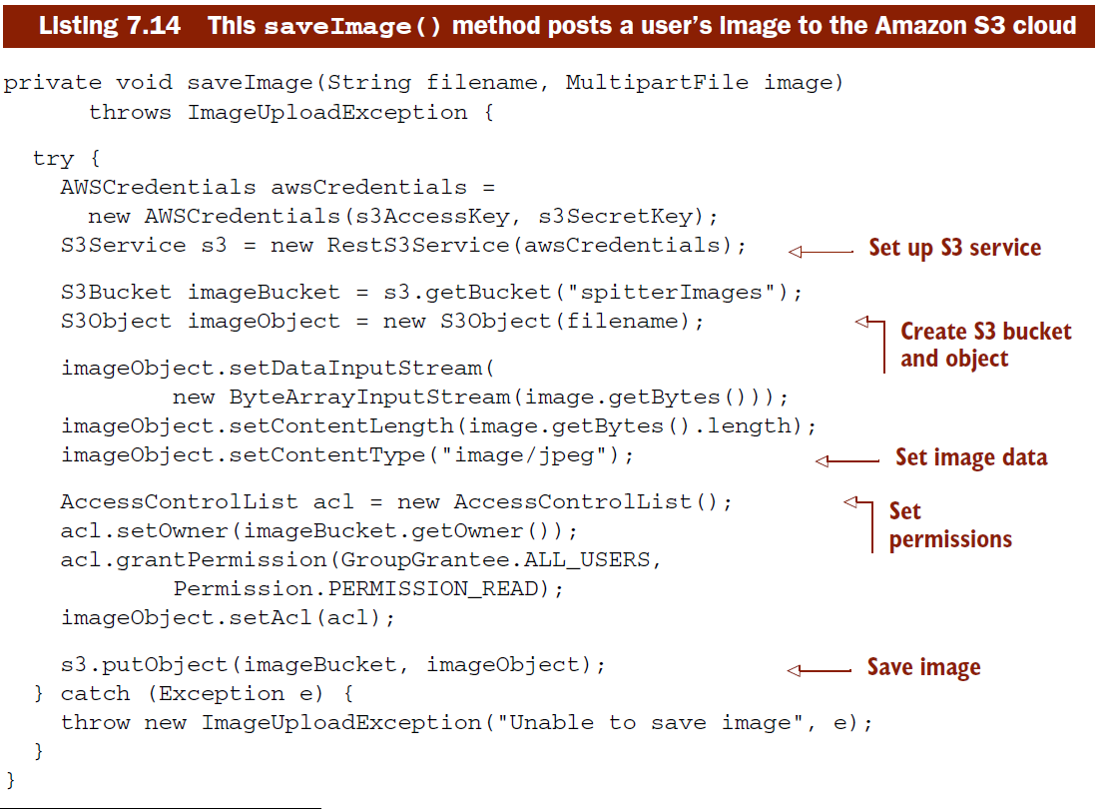

Slide 76
7.5.3 Configuring Spring for file uploads
On its own, DispatcherServlet doesn’t know how to deal with multipart form data.
When DispatcherServlet looks for a multipart resolver, it’ll look for it as a bean whose ID is multipartResolver

Slide 77
-End of Chapter 7-

